Slide 1
Introduction to NLP
Week 1: Lecture 1

Slide 2
Books and Materials
Reference Books
Daniel Jurafsky and James H. Martin. 2009. Speech and Language Processing: An Introduction to Natural Language Processing, Speech Recognition, and Computational Linguistics. 2nd edition. Prentice-Hall.
Christopher D. Manning and Hinrich Schütze. 1999. Foundations of Statistical Natural Language Processing. MIT Press.
Lecture Material Lecture Slides IPython Notebooks
Week 1: Lecture 1
3 / 9

Slide 3
Why study NLP?
Text is the largest repository of human knowledge
news articles, web pages, scientific articles, patents, emails, government documents ....
Introduction to the Course
Week 1: Lecture 1
7 / 9

Slide 4
Why study NLP?
Text is the largest repository of human knowledge
news articles, web pages, scientific articles, patents, emails, government documents ....
Tweets, Facebook posts, comments, Quora ...
Introduction to the Course
Week 1: Lecture 1
7 / 9

Slide 5
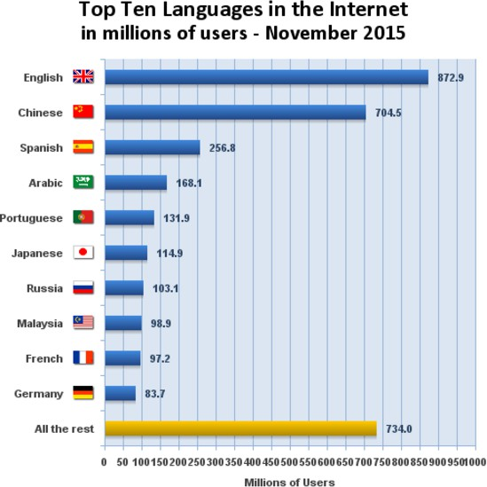
Why study NLP?
¹ You could not understand the majority of the world’s data
¹Source: Internet world statistics
Introduction to the Course
Week 1: Lecture 1

Slide 6
What is NLP?
Introduction to the Course
Week 1: Lecture 1
9 / 9

Slide 7
What is NLP?
Fundamental and Scientific Goal
Deep understanding of broad language
Introduction to the Course
Week 1: Lecture 1
9 / 9

Slide 8
What is NLP?
Fundamental and Scientific Goal
Deep understanding of broad language
Engineering Goal
Design, implement, and test systems that process natural languages for practical applications
Introduction to the Course
Week 1: Lecture 1
9 / 9

Slide 9
What do we do in NLP?
What do we do in NLP?
Module 1: Lecture 2

Slide 10
What is NLP?
Fundamental and Scientific Goal
Deep understanding of broad language
Engineering Goal
Design, implement, and test systems that process natural languages for practical applications
What do we do in NLP?
Module 1: Lecture 2

Slide 11
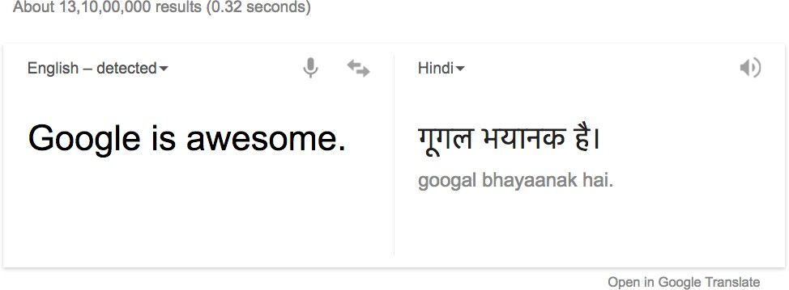
Goals can be very ambitious: Good quality translation
What do we do in NLP?
Module 1: Lecture 2

Slide 12
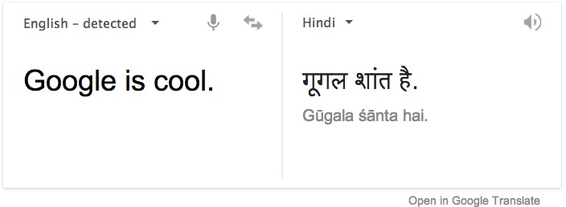
Goals can be very ambitious: Good quality translation
What do we do in NLP?
Module 1: Lecture 2

Slide 13
Well, even humans have made blunders
Pepsi Chinese blunder
“Come alive with the Pepsi Generation”, when translated into Chinese meant, “Pepsi brings your relatives back from the dead.”
What do we do in NLP?
Module 1: Lecture 2
5 / 14

Slide 14
Well, even humans have made blunders
Pepsi Chinese blunder
“Come alive with the Pepsi Generation”, when translated into Chinese meant, “Pepsi brings your relatives back from the dead.”
KFC’s Chinese blunder
KFC’s slogan, “Finger lickin’ good”, when translated into Chinese meant “We’ll eat your fingers off.”
What do we do in NLP?
Module 1: Lecture 2
5 / 14

Slide 15

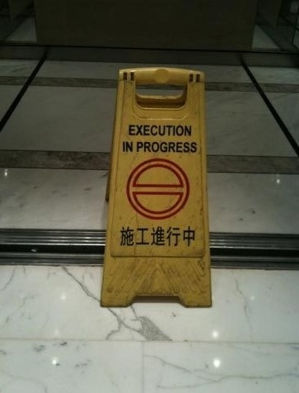
Well, even humans ...
What do we do in NLP?
Module 1: Lecture 2

Slide 16
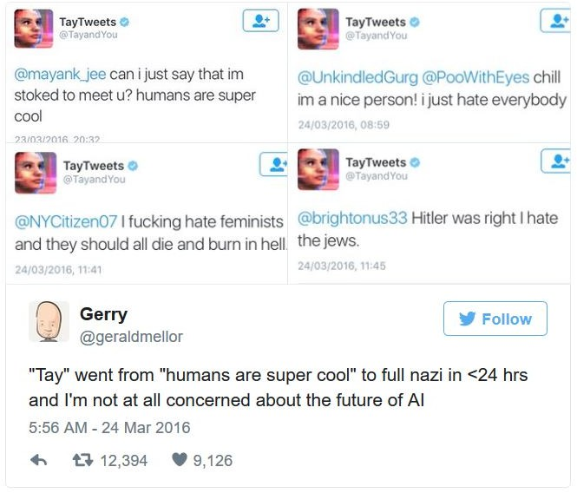
Goals can be very ambitious: Open Domain Chatbots
What do we do in NLP?
Module 1: Lecture 2

Slide 17
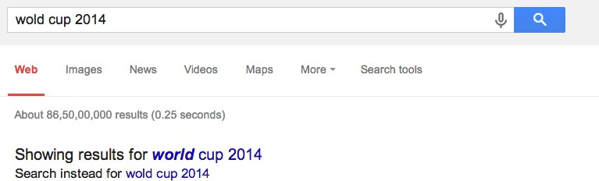
And Goals Can be Practical: Auto Completion
What do we do in NLP?
Module 1: Lecture 2

Slide 18
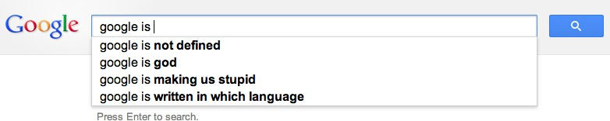
And Goals can be Practical: Search Engines
What do we do in NLP?
Module 1: Lecture 2

Slide 19
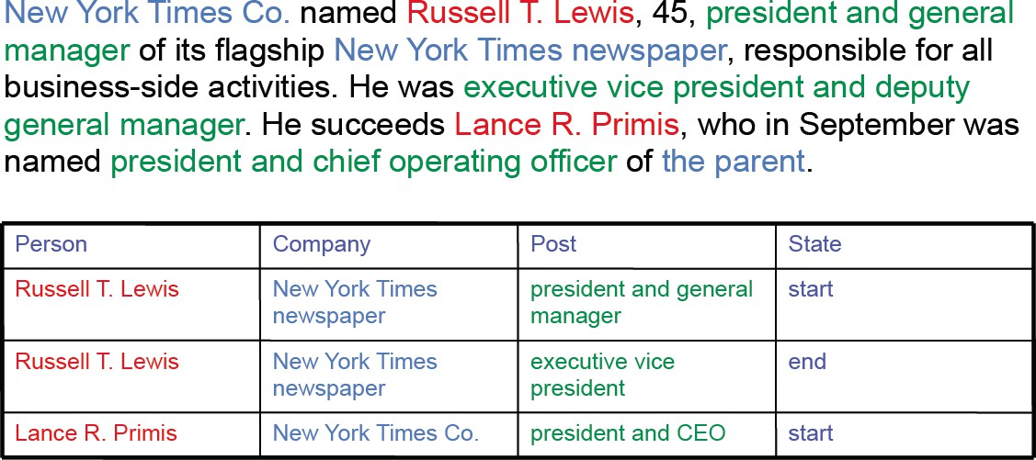
And Goals can be Practical: Information Extraction
What do we do in NLP?
Module 1: Lecture 2

Slide 20
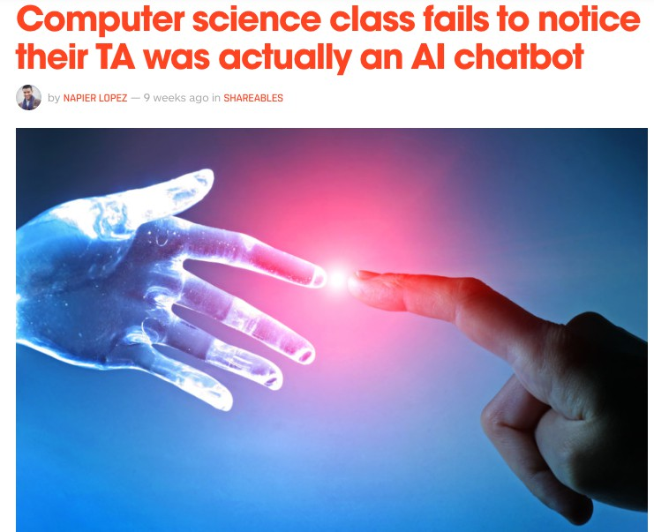
And Goals can be Practical: Domain-specific Chatbots
What do we do in NLP?
Module 1: Lecture 2

Slide 21
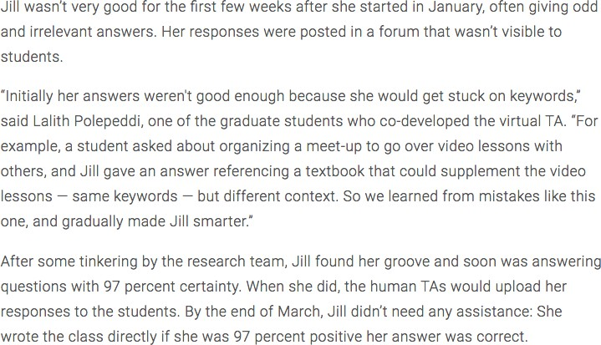
And Goals can be Practical: Domain-specific Chatbots
1
¹http://www.news.gatech.edu/2016/05/09/artificial-intelligence-course-creates-ai-teaching-assist
What do we do in NLP?
Module 1: Lecture 2

Slide 22

And Goals can be Practical: Sentiment Analysis
What do we do in NLP?
Module 1: Lecture 2

Slide 23
Other Goals
Spam detection
Machine Translation services on the Web Text Summarization
. . .
What do we do in NLP?
Module 1: Lecture 2
14 / 14

Slide 24
Other Goals
Spam detection
Machine Translation services on the Web Text Summarization
. . .
Natural Language Technology not yet perfect
But still good enough for several useful applications
What do we do in NLP?
Module 1: Lecture 2
14 / 14

Slide 25
Why is NLP hard?
Why is NLP hard?
Week 1: Lecture 3

Slide 26
Why is NLP hard?
Lexical Ambiguity
Will Will will Will’s will?
Why is NLP hard?
Week 1: Lecture 3
2 / 16

Slide 27
Why is NLP hard?
Lexical Ambiguity
Will Will will Will’s will?
Rose rose to put rose roes on her rows of roses.
Why is NLP hard?
Week 1: Lecture 3
2 / 16

Slide 28
Why is NLP hard?
Lexical Ambiguity
Will Will will Will’s will?
Rose rose to put rose roes on her rows of roses.
Buffalo buffalo Buffalo buffalo buffalo buffalo Buffalo buffalo.
Why is NLP hard?
Week 1: Lecture 3
2 / 16

Slide 29
Why is NLP hard?
Lexical Ambiguity
Will Will will Will’s will?
Rose rose to put rose roes on her rows of roses.
Buffalo buffalo Buffalo buffalo buffalo buffalo Buffalo buffalo.
→ Buffaloes from Buffalo, NY, whom buffaloes from Buffalo bully, bully buffaloes from Buffalo.
Why is NLP hard?
Week 1: Lecture 3
2 / 16

Slide 30
Why is NLP hard?
Language ambiguity: Structural
The man saw the boy with the binoculars. Flying planes can be dangerous.
Hole found in the room wall; police are looking into it.
Language imprecision and vagueness
Why is NLP hard?
Week 1: Lecture 3
3 / 16

Slide 31
Why is NLP hard?
Language ambiguity: Structural
The man saw the boy with the binoculars. Flying planes can be dangerous.
Hole found in the room wall; police are looking into it.
Language imprecision and vagueness
It is very warm here.
Why is NLP hard?
Week 1: Lecture 3
3 / 16

Slide 32
Why is NLP hard?
Language ambiguity: Structural
The man saw the boy with the binoculars. Flying planes can be dangerous.
Hole found in the room wall; police are looking into it.
Language imprecision and vagueness
It is very warm here.
Q: Did your mother call your aunt last night? A: I’m sure she must have.
Why is NLP hard?
Week 1: Lecture 3
3 / 16

Slide 33
But that’s the fun part of it
Why is the teacher wearing sun-glasses?
...
Why is NLP hard?
Week 1: Lecture 3
4 / 16

Slide 34
But that’s the fun part of it
Why is the teacher wearing sun-glasses?
...
Because the class is so bright.
Why is NLP hard?
Week 1: Lecture 3
4 / 16

Slide 35
Ambiguities
News Headlines
Hospitals Are Sued by 7 Foot Doctors
Stolen Painting Found by Tree Teacher Strikes Idle Kids
Why is NLP hard?
Week 1: Lecture 3

Slide 36
Ambiguity is pervasive
Find at least 5 meanings of this sentence:
⁾ I made her duck
Why is NLP hard?
Week 1: Lecture 3
6 / 16

Slide 37
Ambiguity is pervasive
Find at least 5 meanings of this sentence:
⁾ I made her duck
I cooked duck for her
I cooked duck belonging to her
I created the (artificial) duck, she owns
I caused her to quickly lower her head or body
I waved my magic wand and turned her into a duck
Why is NLP hard?
Week 1: Lecture 3
6 / 16

Slide 38
Ambiguity is pervasive
Syntactic Category
‘Duck’ can be a noun or verb
‘her’ can be a possessive (‘of her’) or dative (‘for her’) pronoun
Why is NLP hard?
Week 1: Lecture 3
7 / 16

Slide 39
Ambiguity is pervasive
Syntactic Category
‘Duck’ can be a noun or verb
‘her’ can be a possessive (‘of her’) or dative (‘for her’) pronoun
Word Meaning
‘make’ can mean ‘create’ or ‘cook’
Why is NLP hard?
Week 1: Lecture 3
7 / 16

Slide 40
Ambiguity is pervasive
Grammar
make can be
Transitive: (verb with a noun direct object)
Ditransitive: (verb has 2 noun objects)
Action-transitive: (verb has a direct object + verb)
Why is NLP hard?
Week 1: Lecture 3
8 / 16

Slide 41
Ambiguity is pervasive
Grammar
make can be
Transitive: (verb with a noun direct object)
Ditransitive: (verb has 2 noun objects)
Action-transitive: (verb has a direct object + verb)
Phonetics
I’m eight or duck
I’m aid her duck
Why is NLP hard?
Week 1: Lecture 3
8 / 16

Slide 42
Ambiguity is Explosive
I saw the man with the telescope. 2 parses
Why is NLP hard?
Week 1: Lecture 3
9 / 16

Slide 43
Ambiguity is Explosive
I saw the man with the telescope. 2 parses
I saw the man on the hill with the telescope. 5 parses
Why is NLP hard?
Week 1: Lecture 3
9 / 16

Slide 44
Ambiguity is Explosive
I saw the man with the telescope. 2 parses
I saw the man on the hill with the telescope. 5 parses
I saw the man on the hill in Texas with the telescope. 14 parses
Why is NLP hard?
Week 1: Lecture 3
9 / 16

Slide 45
Ambiguity is Explosive
I saw the man with the telescope. 2 parses
I saw the man on the hill with the telescope. 5 parses
I saw the man on the hill in Texas with the telescope. 14 parses
I saw the man on the hill in Texas with the telescope at noon. 42 parses
Why is NLP hard?
Week 1: Lecture 3
9 / 16

Slide 46
Ambiguity is Explosive
I saw the man with the telescope. 2 parses
I saw the man on the hill with the telescope. 5 parses
I saw the man on the hill in Texas with the telescope. 14 parses
I saw the man on the hill in Texas with the telescope at noon. 42 parses
I saw the man on the hill in Texas with the telescope at noon on Monday.
132 parses
Why is NLP hard?
Week 1: Lecture 3
9 / 16

Slide 47
Why is Language Ambiguous?
The goal in the production and comprehension of natural language is
efficient communication.
Why is NLP hard?
Week 1: Lecture 3
10 / 16

Slide 48
Why is Language Ambiguous?
The goal in the production and comprehension of natural language is
efficient communication.
Allowing resolvable ambiguity
⁾ permits shorter linguistic expressions
Why is NLP hard?
Week 1: Lecture 3
10 / 16

Slide 49
Why is Language Ambiguous?
The goal in the production and comprehension of natural language is
efficient communication.
Allowing resolvable ambiguity
⁾ permits shorter linguistic expressions
⁾ avoids language being overly complex
Why is NLP hard?
Week 1: Lecture 3
10 / 16

Slide 50
Why is Language Ambiguous?
The goal in the production and comprehension of natural language is
efficient communication.
Allowing resolvable ambiguity
⁾ permits shorter linguistic expressions
⁾ avoids language being overly complex
Language relies on people’s ability to use their knowledge and inference abilities to properly resolve ambiguities
Why is NLP hard?
Week 1: Lecture 3
10 / 16

Slide 51
Natural Languages vs. Computer Languages
Ambiguity is the primary difference between natural and computer languages.
Why is NLP hard?
Week 1: Lecture 3
11 / 16

Slide 52
Natural Languages vs. Computer Languages
Ambiguity is the primary difference between natural and computer languages.
Formal programming languages are designed to be unambiguous
Why is NLP hard?
Week 1: Lecture 3
11 / 16

Slide 53
Natural Languages vs. Computer Languages
Ambiguity is the primary difference between natural and computer languages.
Formal programming languages are designed to be unambiguous
⁾ Formal programming languages can be defined by a grammar that produces a unique parse for each sentence in the language.
Why is NLP hard?
Week 1: Lecture 3
11 / 16

Slide 54
Natural Languages vs. Computer Languages
Ambiguity is the primary difference between natural and computer languages.
Formal programming languages are designed to be unambiguous
⁾ Formal programming languages can be defined by a grammar that produces a unique parse for each sentence in the language.
Programming languages are also designed for efficient (deterministic) parsing.
Why is NLP hard?
Week 1: Lecture 3
11 / 16

Slide 55
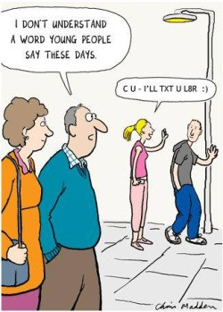
Why else is NLP hard?
Why is NLP hard?
Week 1: Lecture 3

Slide 56
Why else is NLP hard?
Why is NLP hard?
Week 1: Lecture 3
13 / 16

Slide 57





Why is NLP hard?
…………….Target is?????

Slide 58
Why else is NLP hard?
Non-standard English
Great job @justinbieber! Were SOO PROUD of what youve accomplished! U taught us 2 #neversaynever & you yourself should never give up either
Why is NLP hard?
Week 1: Lecture 3
13 / 16

Slide 59
Why else is NLP hard?
Non-standard English
Great job @justinbieber! Were SOO PROUD of what youve accomplished! U taught us 2 #neversaynever & you yourself should never give up either
Segmentation Issues
the New York-New Haven Railroad
Why is NLP hard?
Week 1: Lecture 3
13 / 16

Slide 60
Why else is NLP hard?
Non-standard English
Great job @justinbieber! Were SOO PROUD of what youve accomplished! U taught us 2 #neversaynever & you yourself should never give up either
Segmentation Issues
the New York-New Haven Railroad
the [New] [York-New] [Haven] [Railroad]
Why is NLP hard?
Week 1: Lecture 3
13 / 16

Slide 61
Why else is NLP hard?
Non-standard English
Great job @justinbieber! Were SOO PROUD of what youve accomplished! U taught us 2 #neversaynever & you yourself should never give up either
Segmentation Issues
the New York-New Haven Railroad
the [New] [York-New] [Haven] [Railroad]
the [New York]-[New Haven] [Railroad]
Why is NLP hard?
Week 1: Lecture 3
13 / 16

Slide 62
Why else is NLP hard?
Idioms
dark horse
Ball in your court Burn the midnight oil
Why is NLP hard?
Week 1: Lecture 3
14 / 16

Slide 63
Why else is NLP hard?
Idioms
dark horse
Ball in your court Burn the midnight oil
neologisms
unfriend retweet
Google/Skype/photoshop
Why is NLP hard?
Week 1: Lecture 3
14 / 16

Slide 64
Why is NLP hard?
New Senses of a word That’s sick dude! Giants
Why is NLP hard?
Week 1: Lecture 3
15 / 16

Slide 65
Why is NLP hard?
New Senses of a word
That’s sick dude!
Giants ... multinationals, conglomerates, manufacturers
Why is NLP hard?
Week 1: Lecture 3
15 / 16

Slide 66
Why is NLP hard?
New Senses of a word
That’s sick dude!
Giants ... multinationals, conglomerates, manufacturers
Tricky Entity Names
Where is A Bug’s Life playing ...
Let It Be was recorded ...
Why is NLP hard?
Week 1: Lecture 3
15 / 16

Slide 67
What we do in NLP?
Tools Required
Knowledge about language Knowledge about the world
A way to combine knowledge resources
Why is NLP hard?
Week 1: Lecture 3
16 / 16

Slide 68
What we do in NLP?
Tools Required
Knowledge about language Knowledge about the world
A way to combine knowledge resources
How is it generally done?
Probabilistic models built from language data
⁾ P(“maison” → “house”) is high
Why is NLP hard?
Week 1: Lecture 3
16 / 16

Slide 69
What we do in NLP?
Tools Required
Knowledge about language Knowledge about the world
A way to combine knowledge resources
How is it generally done?
Probabilistic models built from language data
⁾ P(“maison” → “house”) is high
⁾ P(I saw a van) > P(eyes awe of an)
Extracting rough text features does half the job.
Why is NLP hard?
Week 1: Lecture 3
16 / 16

Slide 70
Regular Expressions
Refer to class notes discussed problems-

Slide 71
Classical NLP Vs Modern NLP
A Conceptual Comparison

Slide 72
Introduction
Natural Language Processing (NLP) has evolved significantly over time. Classical NLP relied on rule-based and statistical models, whereas modern NLP leverages deep learning and transformer-based architectures.

Slide 73
Approach & Techniques
Classical NLP:
- Rule-based and Statistical models
- Handcrafted linguistic rules
- Methods: HMM, CRF, SVM, Naïve Bayes
Modern NLP:
- Deep learning-based approaches
- Self-learning neural networks
- Methods: Transformers (BERT, GPT), RNNs, CNNs

Slide 74
Feature Representation
Classical NLP:
- Handcrafted features (TF-IDF, N-grams, POS tagging)
- Requires domain expertise
Modern NLP:
- Automatic feature learning using deep networks
- Word embeddings (Word2Vec, GloVe, BERT embeddings)

Slide 75
Scalability & Data Requirements
Classical NLP:
- Works well with small datasets
- Performance limited by manual feature engineering
Modern NLP:
- Requires large datasets for pre-training
- Pre-trained models can be fine-tuned with minimal data

Slide 76
Interpretability & Explainability
Classical NLP:
- More interpretable due to rule-based structures
- Features like TF-IDF and N-grams are understandable
Modern NLP:
- Black-box nature due to deep learning models
- Explainability tools (SHAP, attention visualization)

Slide 77
Generalization & Adaptability
Classical NLP:
- Task-specific models
- Poor generalization across different domains
Modern NLP:
- Pre-trained models generalize well
- Few-shot and zero-shot learning capabilities

Slide 78
Applications & Evolution
Classical NLP:
- Machine Translation: Rule-based, Statistical MT
- Sentiment Analysis: Naïve Bayes, SVM with TF-IDF
Modern NLP:
- Machine Translation: Transformer-based (Google Translate)
- Sentiment Analysis: BERT-based models

Slide 79
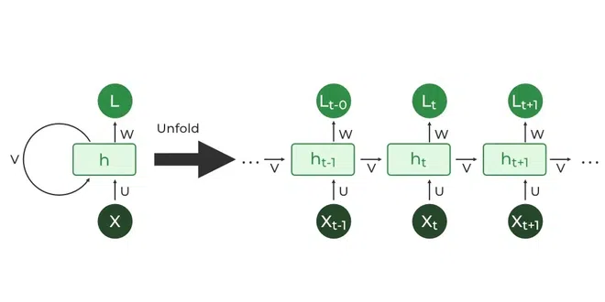

Slide 80
Conclusion
Classical NLP relied on rule-based and statistical methods, requiring extensive manual effort. Modern NLP leverages deep learning, particularly transformers, for improved generalization and scalability.

Slide 81
Empirical Laws
Empirical Laws
Week 1: Lecture 4

Slide 82
Function Words vs. Content Words
Function words have little lexical meaning but serve as important elements to the structure of sentences.
Empirical Laws
Week 1: Lecture 4
2 / 15

Slide 83
Function Words vs. Content Words
Function words have little lexical meaning but serve as important elements to the structure of sentences.
Example
The winfy prunkilmonger from the glidgement mominkled and brangified
all his levensers vederously.
Glop angry investigator larm blonk government harassed gerfritz
infuriated sutbor pumrog listeners thoroughly.
Empirical Laws
Week 1: Lecture 4
2 / 15

Slide 84
Function Words vs. Content Words
Function words have little lexical meaning but serve as important elements to the structure of sentences.
Example
The winfy prunkilmonger from the glidgement mominkled and brangified
all his levensers vederously.
Glop angry investigator larm blonk government harassed gerfritz
infuriated sutbor pumrog listeners thoroughly.
Function words are closed-class words
prepositions, pronouns, auxiliary verbs, conjunctions, grammatical articles, particles etc.
Empirical Laws
Week 1: Lecture 4
2 / 15

Slide 85
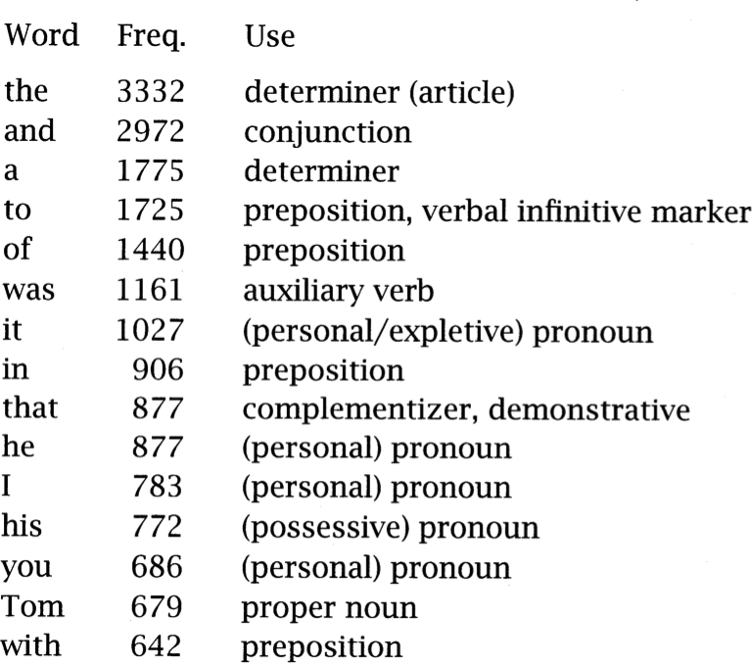
Most Common Words in Tom Sawyer
Empirical Laws
Week 1: Lecture 4
3 / 15

Slide 86
Most Common Words in Tom Sawyer
The list is dominated by the little words of English, having important grammatical roles.
Empirical Laws
Week 1: Lecture 4
3 / 15

Slide 87
Most Common Words in Tom Sawyer
These are usually referred to as function words, such as determiners,
prepositions, complementizers etc.
Empirical Laws
Week 1: Lecture 4
3 / 15

Slide 88
Most Common Words in Tom Sawyer
The one really exceptional word is Tom, whose frequency reflects the text chosen.
Empirical Laws
Week 1: Lecture 4
3 / 15

Slide 89
Most Common Words in Tom Sawyer
How many words are there in this text?
Empirical Laws
Week 1: Lecture 4

Slide 90
Type vs. Tokens
Type-Token distinction
Type-token distinction is a distinction that separates a concept from the objects which are particular instances of the concept
Empirical Laws
Week 1: Lecture 4
4 / 15

Slide 91
Type vs. Tokens
Type-Token distinction
Type-token distinction is a distinction that separates a concept from the objects which are particular instances of the concept
Type/Token Ratio
The type/token ratio (TTR) is the ratio of the number of different words (types) to the number of running words (tokens) in a given text or corpus.
This index indicates how often, on average, a new ‘word form’ appears in the text or corpus.
Empirical Laws
Week 1: Lecture 4
4 / 15

Slide 92
Comparison Across Texts
Mark Twain’s Tom Sawyer
71,370 word tokens
8,018 word types
TTR = 0.112
Complete Shakespeare work
884,647 word tokens
29,066 word types
TTR = 0.032
Empirical Laws
Week 1: Lecture 4

Slide 93
Empirical Observations on Various Texts
Comparing Conversation, academic prose, news, fiction
Empirical Laws
Week 1: Lecture 4
6 / 15

Slide 94
Empirical Observations on Various Texts
Comparing Conversation, academic prose, news, fiction
TTR scores the lowest value (tendency to use the same words) in conversation.
Empirical Laws
Week 1: Lecture 4
6 / 15

Slide 95
Empirical Observations on Various Texts
Comparing Conversation, academic prose, news, fiction
TTR scores the lowest value (tendency to use the same words) in conversation.
TTR scores the highest value (tendency to use different words) in news.
Empirical Laws
Week 1: Lecture 4
6 / 15

Slide 96
Empirical Observations on Various Texts
Comparing Conversation, academic prose, news, fiction
TTR scores the lowest value (tendency to use the same words) in conversation.
TTR scores the highest value (tendency to use different words) in news. Academic prose writing has the second lowest TTR.
Empirical Laws
Week 1: Lecture 4
6 / 15

Slide 97
Empirical Observations on Various Texts
Comparing Conversation, academic prose, news, fiction
TTR scores the lowest value (tendency to use the same words) in conversation.
TTR scores the highest value (tendency to use different words) in news. Academic prose writing has the second lowest TTR.
Not a valid measure of ‘text complexity’ by itself
The value varies with the size of the text.
For a valid measure, a running average is computed on consecutive 1000-word chunks of the text.
Empirical Laws
Week 1: Lecture 4
6 / 15

Slide 98
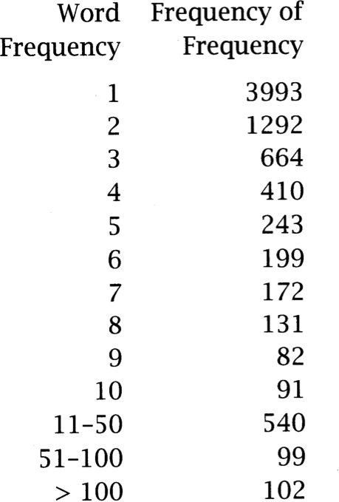
Word Distribution from Tom Sawyer
TTR = 0.11 ⇒ Words occur on average 9 times each.
But words have a very uneven distribution.
Empirical Laws
Week 1: Lecture 4
7 / 15

Slide 99
Word Distribution from Tom Sawyer
TTR = 0.11 ⇒ Words occur on average 9 times each.
But words have a very uneven distribution.
Most words are rare
3993 (50%) word types appear only once
They are called happax legomena
(Greek for ‘read only once’)
Empirical Laws
Week 1: Lecture 4
7 / 15

Slide 100
Word Distribution from Tom Sawyer
TTR = 0.11 ⇒ Words occur on average 9 times each.
But words have a very uneven distribution.
Most words are rare
3993 (50%) word types appear only once
They are called happax legomena
(Greek for ‘read only once’)
But common words are very common
100 words account for 51% of all tokens of all text
Empirical Laws
Week 1: Lecture 4
7 / 15

Slide 101
Zipf’s Law
Count the frequency of each word type in a large corpus List the word types in decreasing order of their frequency
Empirical Laws
Week 1: Lecture 4
8 / 15

Slide 102
Zipf’s Law
Count the frequency of each word type in a large corpus List the word types in decreasing order of their frequency
Zipf’s Law
A relationship between the frequency of a word (f ) and its position in the list (its rank r).
Empirical Laws
Week 1: Lecture 4
8 / 15

Slide 103
Zipf’s Law
Count the frequency of each word type in a large corpus List the word types in decreasing order of their frequency
Zipf’s Law
A relationship between the frequency of a word (f ) and its position in the list (its rank r).
f ∝ ¹
r
Empirical Laws
Week 1: Lecture 4
8 / 15

Slide 104
Zipf’s Law
Count the frequency of each word type in a large corpus List the word types in decreasing order of their frequency
Zipf’s Law
A relationship between the frequency of a word (f ) and its position in the list (its rank r).
f ∝ ¹
r
or, there is a constant k such that
f .r = k
Empirical Laws
Week 1: Lecture 4
8 / 15

Slide 105
Zipf’s Law
Count the frequency of each word type in a large corpus List the word types in decreasing order of their frequency
Zipf’s Law
A relationship between the frequency of a word (f ) and its position in the list (its rank r).
f ∝ ¹
r
or, there is a constant k such that
f .r = k
i.e. the 50th most common word should occur with 3 times the frequency of the 150th most common word.
Empirical Laws
Week 1: Lecture 4
8 / 15

Slide 106
Zipf’s Law
Let
p_{r} denote the probability of word of rank r
N denote the total number of word occurrences
Empirical Laws
Week 1: Lecture 4
9 / 15

Slide 107
Zipf’s Law
Let
p_{r} denote the probability of word of rank r
N denote the total number of word occurrences
p_{r} = ^{f} = ^{A}
N r
Empirical Laws
Week 1: Lecture 4
9 / 15

Slide 108
Zipf’s Law
Let
p_{r} denote the probability of word of rank r
N denote the total number of word occurrences
p_{r} = ^{f} = ^{A}
N r
The value of A is found closer to 0.1 for corpus
Empirical Laws
Week 1: Lecture 4
9 / 15

Slide 109
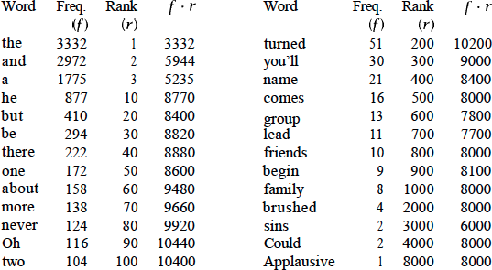
Empirical Evaluation from Tom Sawyer
Empirical Laws
Week 1: Lecture 4

Slide 110
Zipf’s Other Laws
Correlation: Number of meanings and word frequency
The number of meanings m of a word obeys the law:
m ∝ √f
Empirical Laws
Week 1: Lecture 4
11 / 15

Slide 111
Zipf’s Other Laws
Correlation: Number of meanings and word frequency
The number of meanings m of a word obeys the law:
m ∝ √f
Given the First law
1
m ∝ √_{r}
Empirical Laws
Week 1: Lecture 4
11 / 15

Slide 112
Zipf’s Other Laws
Correlation: Number of meanings and word frequency
The number of meanings m of a word obeys the law:
m ∝ √f
Given the First law
1
m ∝ √_{r}
Empirical Support
Rank ≈ 10000, average 2.1 meanings
Rank ≈ 5000, average 3 meanings
Rank ≈ 2000, average 4.6 meanings
Empirical Laws
Week 1: Lecture 4
11 / 15

Slide 113
Zipf’s Other Laws
Correlation: Word length and word frequency
Word frequency is inversely proportional to their length.
Empirical Laws
Week 1: Lecture 4

Slide 114
Impact of Zipf’s Law
The Good part
Stopwords account for a large fraction of text, thus eliminating them greatly reduces the number of tokens in a text.
Empirical Laws
Week 1: Lecture 4
13 / 15

Slide 115
Impact of Zipf’s Law
The Good part
Stopwords account for a large fraction of text, thus eliminating them greatly reduces the number of tokens in a text.
The Bad part
Most words are extremely rare and thus, gathering sufficient data for meaningful statistical analysis is difficult for most words.
Empirical Laws
Week 1: Lecture 4
13 / 15

Slide 116
Vocabulary Growth
How does the size of the overall vocabulary (number of unique words) grow with the size of the corpus?
Empirical Laws
Week 1: Lecture 4
14 / 15

Slide 117
Vocabulary Growth
How does the size of the overall vocabulary (number of unique words) grow with the size of the corpus?
Heaps’ Law
Let |V| be the size of vocabulary and N be the number of tokens.
Empirical Laws
Week 1: Lecture 4
14 / 15

Slide 118
Vocabulary Growth
How does the size of the overall vocabulary (number of unique words) grow with the size of the corpus?
Heaps’ Law
Let |V| be the size of vocabulary and N be the number of tokens.
|V| = KN^{β}
Typically
K ≈ 10-100
β ≈ 0.4 - 0.6 (roughly square root)
Empirical Laws
Week 1: Lecture 4
14 / 15

Slide 119
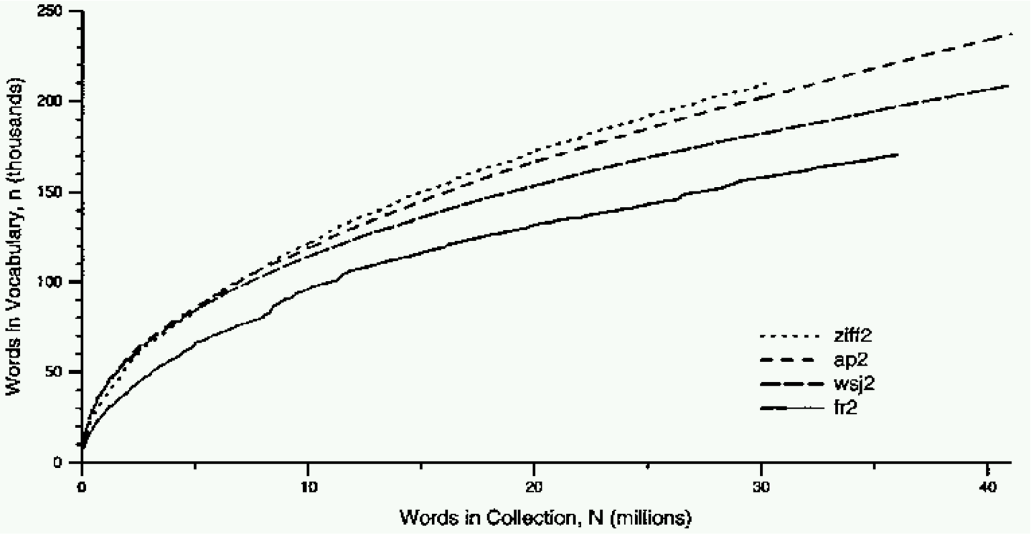
Heaps’ Law: Empirical Evidence
Empirical Laws
Week 1: Lecture 4
15 / 15

Slide 120
Text Processing: Basics
Text Processing: Basics
Week 1: Lecture 5
1 / 26

Slide 121
Text processing: tokenization
What is Tokenization?
Tokenization is the process of segmenting a string of characters into words.
Depending on the application in hand, you might have to perform sentence segmentation as well.
Text Processing: Basics
Week 1: Lecture 5

Slide 122
Sentence Segmentation
The problem of deciding where the sentences begin and end.
Challenges Involved
Text Processing: Basics
Week 1: Lecture 5
3 / 26

Slide 123
Sentence Segmentation
The problem of deciding where the sentences begin and end.
Challenges Involved
While ‘!’, ‘?’ are quite unambiguous
Text Processing: Basics
Week 1: Lecture 5
3 / 26

Slide 124
Sentence Segmentation
The problem of deciding where the sentences begin and end.
Challenges Involved
While ‘!’, ‘?’ are quite unambiguous
Period “.” is quite ambiguous and can be used additionally for
⁾ Abbreviations (Dr., Mr., m.p.h.)
Text Processing: Basics
Week 1: Lecture 5
3 / 26

Slide 125
Sentence Segmentation
The problem of deciding where the sentences begin and end.
Challenges Involved
While ‘!’, ‘?’ are quite unambiguous
Period “.” is quite ambiguous and can be used additionally for
⁾ Abbreviations (Dr., Mr., m.p.h.)
⁾ Numbers (2.4%, 4.3)
Text Processing: Basics
Week 1: Lecture 5
3 / 26

Slide 126
Sentence Segmentation
The problem of deciding where the sentences begin and end.
Challenges Involved
While ‘!’, ‘?’ are quite unambiguous
Period “.” is quite ambiguous and can be used additionally for
⁾ Abbreviations (Dr., Mr., m.p.h.)
⁾ Numbers (2.4%, 4.3)
Approach: build a binary classifier
For each “.”
Decides EndOfSentence/NotEndOfSentence
Text Processing: Basics
Week 1: Lecture 5
3 / 26

Slide 127
Sentence Segmentation
The problem of deciding where the sentences begin and end.
Challenges Involved
While ‘!’, ‘?’ are quite unambiguous
Period “.” is quite ambiguous and can be used additionally for
⁾ Abbreviations (Dr., Mr., m.p.h.)
⁾ Numbers (2.4%, 4.3)
Approach: build a binary classifier
For each “.”
Decides EndOfSentence/NotEndOfSentence
Classifiers can be: hand-written rules, regular expressions, or machine learning
Text Processing: Basics
Week 1: Lecture 5
3 / 26

Slide 128
Sentence Segmentation: Decision Tree Example
Decision Tree: Is this word the end-of-sentence (E-O-S)?
Text Processing: Basics
Week 1: Lecture 5
4 / 26

Slide 129
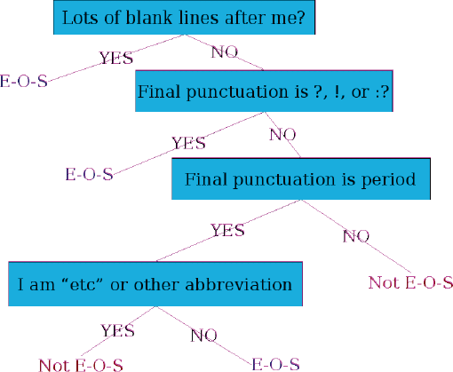
Sentence Segmentation: Decision Tree Example
Decision Tree: Is this word the end-of-sentence (E-O-S)?
Text Processing: Basics
Week 1: Lecture 5
4 / 26

Slide 130
Other Important Features
Text Processing: Basics
Week 1: Lecture 5
5 / 26

Slide 131
Other Important Features
Case of word with “.”: Upper, Lower, Cap, Number
Text Processing: Basics
Week 1: Lecture 5
5 / 26

Slide 132
Other Important Features
Case of word with “.”: Upper, Lower, Cap, Number Case of word after “.”: Upper, Lower, Cap, Number
Text Processing: Basics
Week 1: Lecture 5
5 / 26

Slide 133
Other Important Features
Case of word with “.”: Upper, Lower, Cap, Number Case of word after “.”: Upper, Lower, Cap, Number Numeric Features
Text Processing: Basics
Week 1: Lecture 5
5 / 26

Slide 134
Other Important Features
Case of word with “.”: Upper, Lower, Cap, Number Case of word after “.”: Upper, Lower, Cap, Number Numeric Features
⁾ Length of word with “.”
Text Processing: Basics
Week 1: Lecture 5
5 / 26

Slide 135
Other Important Features
Case of word with “.”: Upper, Lower, Cap, Number Case of word after “.”: Upper, Lower, Cap, Number Numeric Features
⁾ Length of word with “.”
⁾ Probability (word with “.” occurs at end-of-sentence)
Text Processing: Basics
Week 1: Lecture 5
5 / 26

Slide 136
Other Important Features
Case of word with “.”: Upper, Lower, Cap, Number Case of word after “.”: Upper, Lower, Cap, Number Numeric Features
⁾ Length of word with “.”
⁾ Probability (word with “.” occurs at end-of-sentence)
⁾ Probability (word after “.” occurs at beginning-of-sentence)
Text Processing: Basics
Week 1: Lecture 5
5 / 26

Slide 137
Implementing Decision Trees
Text Processing: Basics
Week 1: Lecture 5
6 / 26

Slide 138
Implementing Decision Trees
Just an if-then-else statement
Text Processing: Basics
Week 1: Lecture 5
6 / 26

Slide 139
Implementing Decision Trees
Just an if-then-else statement
Choosing the features is more important
Text Processing: Basics
Week 1: Lecture 5
6 / 26

Slide 140
Implementing Decision Trees
Just an if-then-else statement
Choosing the features is more important
For numeric features, thresholds are to be picked
Text Processing: Basics
Week 1: Lecture 5
6 / 26

Slide 141
Implementing Decision Trees
Just an if-then-else statement
Choosing the features is more important
For numeric features, thresholds are to be picked
With increasing features including numerical ones, difficult to set up the structure by hand
Text Processing: Basics
Week 1: Lecture 5
6 / 26

Slide 142
Implementing Decision Trees
Just an if-then-else statement
Choosing the features is more important
For numeric features, thresholds are to be picked
With increasing features including numerical ones, difficult to set up the structure by hand
Decision Tree structure can be learned using machine learning over a training corpus
Text Processing: Basics
Week 1: Lecture 5
6 / 26

Slide 143
Implementing Decision Trees
Just an if-then-else statement
Choosing the features is more important
For numeric features, thresholds are to be picked
With increasing features including numerical ones, difficult to set up the structure by hand
Decision Tree structure can be learned using machine learning over a training corpus
Basic Idea
Usually works top-down, by choosing a variable at each step that best splits the set of items.
Popular algorithms: ID3, C4.5, CART
Text Processing: Basics
Week 1: Lecture 5
6 / 26

Slide 144
Other Classifiers
Text Processing: Basics
Week 1: Lecture 5
7 / 26

Slide 145
Other Classifiers
The questions in the decision tree can be thought of as features, that could be exploited by any other classifier:
Text Processing: Basics
Week 1: Lecture 5
7 / 26

Slide 146
Other Classifiers
The questions in the decision tree can be thought of as features, that could be exploited by any other classifier:
Support Vector Machines Logistic regression Neural Networks
Text Processing: Basics
Week 1: Lecture 5
7 / 26

Slide 147
Word Tokenization
What is Tokenization?
Tokenization is the process of segmenting a string of characters into words.
Text Processing: Basics
Week 1: Lecture 5
8 / 26

Slide 148
Word Tokenization
What is Tokenization?
Tokenization is the process of segmenting a string of characters into words.
I have a can opener; but I can’t open these cans.
Word Token
An occurrence of a word
For the above sentence, 11 word tokens.
Word Type
A different realization of a word
For the above sentence, 10 word types.
Text Processing: Basics
Week 1: Lecture 5
8 / 26

Slide 149
NLTK Toolkit (Python) Stanford CoreNLP (Java) Unix Commands
Tokenization in practice
Text Processing: Basics
Week 1: Lecture 5

Slide 150
Word Tokenization
Text Processing: Basics
Week 1: Lecture 5
10 / 26

Slide 151
Word Tokenization
Issues in Tokenization
Finland’s → Finland Finlands Finland’s ?
What’re, I’m, shouldn’t → What are, I am, should not ? San Francisco → one token or two?
m.p.h. → ??
Text Processing: Basics
Week 1: Lecture 5
10 / 26

Slide 152
Word Tokenization
Issues in Tokenization
Finland’s → Finland Finlands Finland’s ?
What’re, I’m, shouldn’t → What are, I am, should not ? San Francisco → one token or two?
m.p.h. → ??
For information retrieval, use the same convention for documents and queries
Text Processing: Basics
Week 1: Lecture 5
10 / 26

Slide 153
Handling Hyphenation
Hyphens can be
Text Processing: Basics
Week 1: Lecture 5
11 / 26

Slide 154
Handling Hyphenation
Hyphens can be
End-of-Line Hyphen
Used for splitting whole words into part for text justification.
This paper describes MIMIC, an adaptive mixed initia-tive spoken dialogue system that provides movie show-time information.
Text Processing: Basics
Week 1: Lecture 5
11 / 26

Slide 155
Handling Hyphenation
Hyphens can be
End-of-Line Hyphen
Used for splitting whole words into part for text justification.
This paper describes MIMIC, an adaptive mixed initia-tive spoken dialogue system that provides movie show-time information.
Lexical Hyphen
Certain prefixes are offen written hyphenated, e.g. co-, pre-, meta-, multi-, etc.
Text Processing: Basics
Week 1: Lecture 5
11 / 26

Slide 156
Handling Hyphenation
Hyphens can be
End-of-Line Hyphen
Used for splitting whole words into part for text justification.
This paper describes MIMIC, an adaptive mixed initia-tive spoken dialogue system that provides movie show-time information.
Lexical Hyphen
Certain prefixes are offen written hyphenated, e.g. co-, pre-, meta-, multi-, etc.
Sententially Determined Hyphenation
Mainly to prevent incorrect parsing of the phrase. Some possible usages: Noun modified by an ‘ed’-verb: case-based, hand-delivered
Entire expression as a modifier in a noun group: three-to-five-year direct marketing plan
Text Processing: Basics
Week 1: Lecture 5
11 / 26

Slide 157
Language Specific Issues: French and German
French
l’ensemble: want to match with un ensemble
Text Processing: Basics
Week 1: Lecture 5
12 / 26

Slide 158
Language Specific Issues: French and German
French
l’ensemble: want to match with un ensemble
German
Noun coumpounds are not segmented
Lebensversicherungsgesellschaftsangestellter ‘life insurance company employee’
Compound splitter required for German information retrieval
Text Processing: Basics
Week 1: Lecture 5
12 / 26

Slide 159
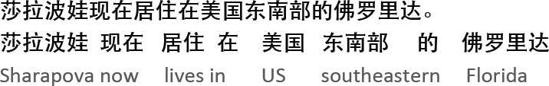
Language Specific Issues: Chinese and Japanese
No space between words
Text Processing: Basics
Week 1: Lecture 5
13 / 26

Slide 160
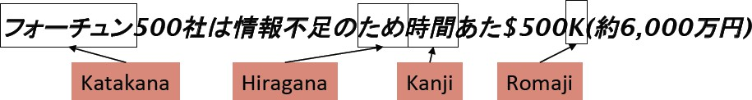
Language Specific Issues: Chinese and Japanese
No space between words
Japanese: further complications with multiple alphabets intermingled.
Text Processing: Basics
Week 1: Lecture 5
13 / 26

Slide 161
Language Specific Issues: Sanskrit
satyam. bru¯ ya¯ tpriyam. bru¯ ya¯ nnabru¯ ya¯ tsatyamapriyam. priyam. cana¯ n.rtambru¯ ya¯ d- es. adharmah. sana¯ tanah. .
“One should tell the truth, one should say kind words; one should neither tell harsh truths, nor flattering lies; this is a rule for all times.”
Text Processing: Basics
Week 1: Lecture 5
14 / 26

Slide 162
Language Specific Issues: Sanskrit
satyam. bru¯ ya¯ tpriyam. bru¯ ya¯ nnabru¯ ya¯ tsatyamapriyam. priyam. cana¯ n.rtambru¯ ya¯ d- es. adharmah. sana¯ tanah. .
“One should tell the truth, one should say kind words; one should neither tell harsh truths, nor flattering lies; this is a rule for all times.”
Segmented Text:
satyam bru¯ ya¯ t priyam bru¯ ya¯ t na bru¯ ya¯ t satyam apriyam priyam ca na an.rtam bru¯ ya¯ t es. ah. dharmah. sana¯ tanah. .
Text Processing: Basics
Week 1: Lecture 5
14 / 26

Slide 163
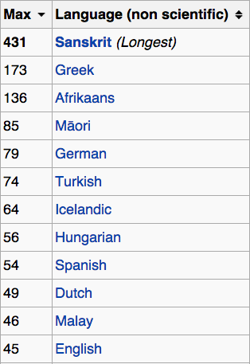
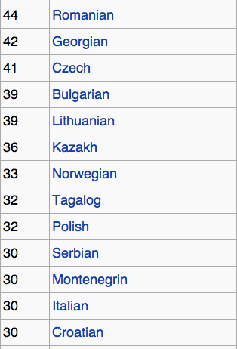
Longest Words
Text Processing: Basics
Week 1: Lecture 5

Slide 164
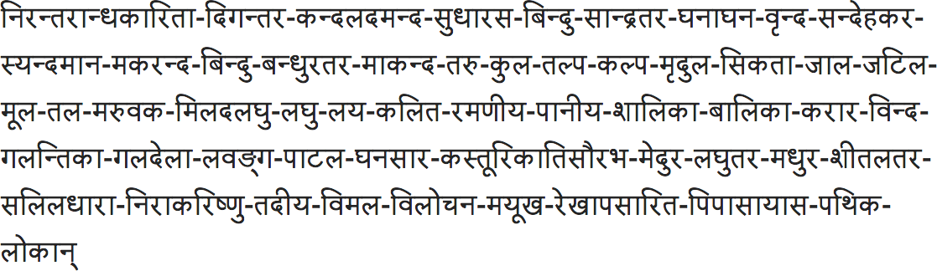
Longest Words
Compound word composed of 431 letters, from the Varada¯ mbika¯ Parin˙aya Campu¯ by Tirumala¯ mba
Text Processing: Basics
Week 1: Lecture 5

Slide 165
Word Tokenization in Chinese or Sanskrit
Also called ‘Word Segmentation’.
Text Processing: Basics
Week 1: Lecture 5
17 / 26

Slide 166
Word Tokenization in Chinese or Sanskrit
Also called ‘Word Segmentation’.
Greedy Algorithm for Chinese
Maximum Matching (Greedy Algorithm)
Start a pointer at the beginning of the string
Find the largest word in dictionary that matches the string starting at pointer
Move the pointer over the word in string
Think of the cases when word segmentation would be required for English Text.
Text Processing: Basics
Week 1: Lecture 5
17 / 26

Slide 167
Word Tokenization in Chinese or Sanskrit
Also called ‘Word Segmentation’.
Greedy Algorithm for Chinese
Maximum Matching (Greedy Algorithm)
Start a pointer at the beginning of the string
Find the largest word in dictionary that matches the string starting at pointer
Move the pointer over the word in string
Think of the cases when word segmentation would be required for English Text.
Finding constituent words in a compound hashtags: #ThankYouSachin, #musicmonday etc.
Text Processing: Basics
Week 1: Lecture 5
17 / 26

Slide 168
Text Segmentation for Sanskrit
General assumption behind the design
Sentences from Classical Sanskrit may be generated by a regular relation R of the Kleene closure W∗ of a regular set W of words over a finite alphabet Σ.
Text Processing: Basics
Week 1: Lecture 5
18 / 26

Slide 169
Text Segmentation for Sanskrit
General assumption behind the design
Sentences from Classical Sanskrit may be generated by a regular relation R of the Kleene closure W∗ of a regular set W of words over a finite alphabet Σ.
W: vocabulary of (inflected) words (padas) and
R: sandhi
Text Processing: Basics
Week 1: Lecture 5
18 / 26

Slide 170
Text Segmentation for Sanskrit
General assumption behind the design
Sentences from Classical Sanskrit may be generated by a regular relation R of the Kleene closure W∗ of a regular set W of words over a finite alphabet Σ.
W: vocabulary of (inflected) words (padas) and
R: sandhi
Analysis of a sentence
A candidate sentence w is analyzed by inverting relation R to produce a finite sequence w₁, w₂,...w_{n} of word forms, together with a proof that
w ∈ R(w₁ · w₂... · w_{n}).
Text Processing: Basics
Week 1: Lecture 5
18 / 26

Slide 171
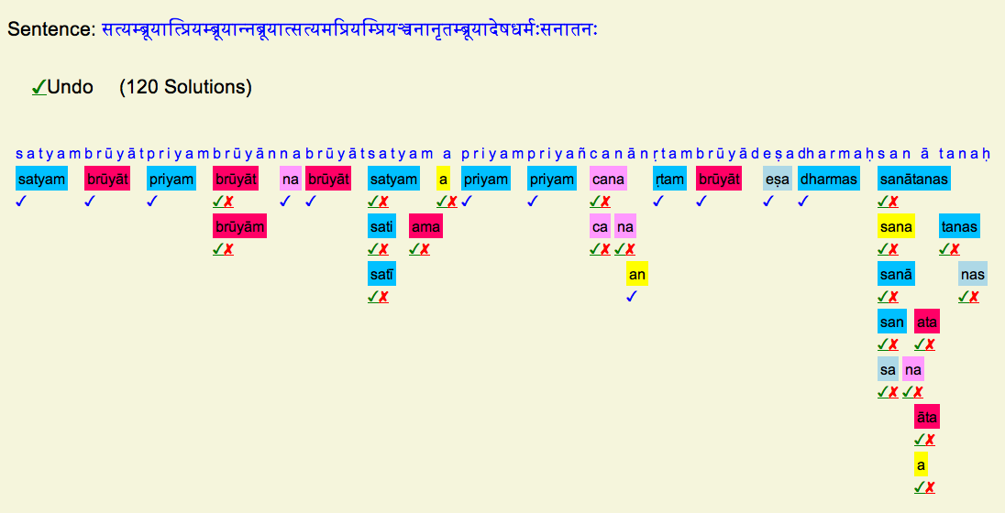
Word Segmentation in Sanskrit
Text Processing: Basics
Week 1: Lecture 5

Slide 172
Normalization
Why to “normalize”?
Indexed text and query terms must have the same form.
U.S.A. and USA should be matched
Text Processing: Basics
Week 1: Lecture 5
20 / 26

Slide 173
Normalization
Why to “normalize”?
Indexed text and query terms must have the same form.
U.S.A. and USA should be matched
We implicitly define equivalence classes of terms
Text Processing: Basics
Week 1: Lecture 5
20 / 26

Slide 174
Case Folding
Reduce all letters to lower case
Text Processing: Basics
Week 1: Lecture 5
21 / 26

Slide 175
Case Folding
Reduce all letters to lower case Possible exceptions (Task dependent):
⁾ Upper case in mid sentence, may point to named entities (e.g. General Motors)
Text Processing: Basics
Week 1: Lecture 5
21 / 26

Slide 176
Case Folding
Reduce all letters to lower case Possible exceptions (Task dependent):
⁾ Upper case in mid sentence, may point to named entities (e.g. General Motors)
⁾ For MT and inforamtion extraction, some cases might be helpful (US vs.
us)
Text Processing: Basics
Week 1: Lecture 5
21 / 26

Slide 177
Lemmatization
Reduce inflections or variant forms to base form:
⁾ am, are, is → be
⁾ car, cars, car’s, cars’ → car
Have to find the correct dictionary headword form
Text Processing: Basics
Week 1: Lecture 5

Slide 178
Morphology
Morphology studies the internal structure of words, how words are built up from smaller meaningful units called morphemes
Text Processing: Basics
Week 1: Lecture 5
23 / 26

Slide 179
Morphology
Morphology studies the internal structure of words, how words are built up from smaller meaningful units called morphemes
Morphemes are divided into two categories
Stems: The core meaning bearing units
Affixes: Bits and pieces adhering to stems to change their meanings and grammatical functions
Text Processing: Basics
Week 1: Lecture 5
23 / 26

Slide 180
Morphology
Morphology studies the internal structure of words, how words are built up from smaller meaningful units called morphemes
Morphemes are divided into two categories
Stems: The core meaning bearing units
Affixes: Bits and pieces adhering to stems to change their meanings and grammatical functions
⁾ Prefix: un-, anti-, etc (a-, ati-, pra- etc.)
Text Processing: Basics
Week 1: Lecture 5
23 / 26

Slide 181
Morphology
Morphology studies the internal structure of words, how words are built up from smaller meaningful units called morphemes
Morphemes are divided into two categories
Stems: The core meaning bearing units
Affixes: Bits and pieces adhering to stems to change their meanings and grammatical functions
⁾ Prefix: un-, anti-, etc (a-, ati-, pra- etc.)
⁾ Suffix: -ity, -ation, etc (-taa, -ke, -ka etc.)
Text Processing: Basics
Week 1: Lecture 5
23 / 26

Slide 182
Morphology
Morphology studies the internal structure of words, how words are built up from smaller meaningful units called morphemes
Morphemes are divided into two categories
Stems: The core meaning bearing units
Affixes: Bits and pieces adhering to stems to change their meanings and grammatical functions
⁾ Prefix: un-, anti-, etc (a-, ati-, pra- etc.)
⁾ Suffix: -ity, -ation, etc (-taa, -ke, -ka etc.)
⁾ Infix: ‘n’ in ‘vindati’ (he knows), as contrasted with vid (to know).
Text Processing: Basics
Week 1: Lecture 5
23 / 26

Slide 183
Reducing terms to their stems, used in information retrieval
Stemming
Text Processing: Basics
Week 1: Lecture 5
24 / 26

Slide 184
Stemming
Reducing terms to their stems, used in information retrieval Crude chopping of affixes
⁾ language dependent
Text Processing: Basics
Week 1: Lecture 5
24 / 26

Slide 185
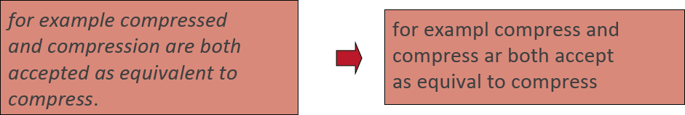
Stemming
Reducing terms to their stems, used in information retrieval Crude chopping of affixes
⁾ language dependent
⁾ automate(s), automatic, automation all reduced to automat
Text Processing: Basics
Week 1: Lecture 5
24 / 26

Slide 186
Porter’s algorithm
Step 1a
sses → ss (caresses → caress) ies → i (ponies → poni)
ss → ss (caress → caress) s → φ (cats → cat)
Text Processing: Basics
Week 1: Lecture 5
25 / 26

Slide 187
Porter’s algorithm
Step 1a
sses → ss (caresses → caress) ies → i (ponies → poni)
ss → ss (caress → caress) s → φ (cats → cat)
Step 1b
(*v*)ing → φ (walking → walk, king →
Text Processing: Basics
Week 1: Lecture 5
25 / 26

Slide 188
Porter’s algorithm
Step 1a
sses → ss (caresses → caress) ies → i (ponies → poni)
ss → ss (caress → caress) s → φ (cats → cat)
Step 1b
(*v*)ing → φ (walking → walk, king → king) (*v*)ed → φ (played → play)
Text Processing: Basics
Week 1: Lecture 5
25 / 26

Slide 189
Porter’s algorithm
Step 2
ational → ate (relational → relate) izer → ize (digitizer → digitize) ator → ate (operator → operate)
Text Processing: Basics
Week 1: Lecture 5
26 / 26

Slide 190
Porter’s algorithm
Step 2
ational → ate (relational → relate) izer → ize (digitizer → digitize) ator → ate (operator → operate)
Step 3
al → φ (revival → reviv)
able → φ (adjustable → adjust) ate → φ (activate → activ)
Text Processing: Basics
Week 1: Lecture 5
26 / 26

Slide 192
Minimum Edit Distance
Definition of Minimum Edit Distance

Slide 193
How similar are two strings?
Spell correction
  The user typed “graffe”
  Which is closest?
    graf
    graft
    grail
    giraffe
Computational Biology
  Align two sequences of nucleotides
  Resulting alignment:
AGGCTATCACCTGACCTCCAGGCCGATGCCC
TAGCTATCACGACCGCGGTCGATTTGCCCGAC
-AGGCTATCACCTGACCTCCAGGCCGA--TGCCC---
TAG-CTATCAC--GACCGC--GGTCGATTTGCCCGAC
Also for Machine Translation, Information Extraction, Speech Recognition

Slide 194
Edit Distance
The minimum edit distance between two strings
Is the minimum number of editing operations
  Insertion
  Deletion
  Substitution
Needed to transform one into the other

Slide 195

Minimum Edit Distance
Two strings and their alignment:

Slide 196
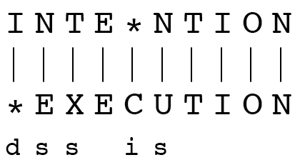
Minimum Edit Distance
If each operation has cost of 1
  Distance between these is 5
If substitutions cost 2 (Levenshtein)
  Distance between them is 8

Slide 197
Alignment in Computational Biology
Given a sequence of bases
An alignment:
Given two sequences, align each letter to a letter or gap
AGGCTATCACCTGACCTCCAGGCCGATGCCC
TAGCTATCACGACCGCGGTCGATTTGCCCGAC
-AGGCTATCACCTGACCTCCAGGCCGA--TGCCC---
TAG-CTATCAC--GACCGC--GGTCGATTTGCCCGAC

Slide 198
Other uses of Edit Distance in NLP
Evaluating Machine Translation and speech recognition
R Spokesman confirms senior government adviser was shot
H Spokesman said the senior adviser was shot dead
S I D I
Named Entity Extraction and Entity Coreference
  IBM Inc. announced today
  IBM profits
  Stanford President John Hennessy announced yesterday
  for Stanford University President John Hennessy

Slide 199
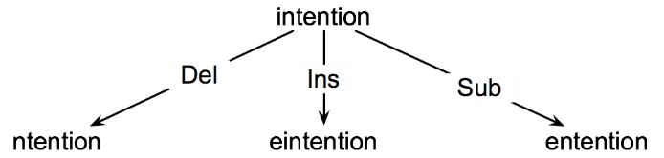
How to find the Min Edit Distance?
Searching for a path (sequence of edits) from the start string to the final string:
  Initial state: the word we’re transforming
  Operators: insert, delete, substitute
  Goal state: the word we’re trying to get to
  Path cost: what we want to minimize: the number of edits

Slide 200
Minimum Edit as Search
But the space of all edit sequences is huge!
  We can’t afford to navigate naïvely
  Lots of distinct paths wind up at the same state.
    We don’t have to keep track of all of them
    Just the shortest path to each of those revisted states.

Slide 201
Defining Min Edit Distance
For two strings
  X of length n
  Y of length m
We define D(i,j)
  the edit distance between X[1..i] and Y[1..j]
    i.e., the first i characters of X and the first j characters of Y
  The edit distance between X and Y is thus D(n,m)

Slide 202
Minimum Edit Distance
Definition of Minimum Edit Distance

Slide 203
Minimum Edit Distance
Computing Minimum Edit Distance

Slide 204
Dynamic Programming for
Minimum Edit Distance
Dynamic programming: A tabular computation of D(n,m)
Solving problems by combining solutions to subproblems.
Bottom-up
  We compute D(i,j) for small i,j
  And compute larger D(i,j) based on previously computed smaller values
  i.e., compute D(i,j) for all i (0 < i < n) and j (0 < j < m)

Slide 205
Defining Min Edit Distance (Levenshtein)
Initialization
  D(i,0) = i
  D(0,j) = j
Recurrence Relation:
  For each i = 1…M
  For each j = 1…N
  D(i-1,j) + 1
  D(i,j)= min D(i,j-1) + 1
  D(i-1,j-1) + 2; if X(i) ≠ Y(j)
  0; if X(i) = Y(j)
Termination:
  D(N,M) is distance

Slide 206
The Edit Distance Table
N | 9
O | 8
I | 7
T | 6
N | 5
E | 4
T | 3
N | 2
I | 1
# | 0 | 1 | 2 | 3 | 4 | 5 | 6 | 7 | 8 | 9
 | # | E | X | E | C | U | T | I | O | N

Slide 207
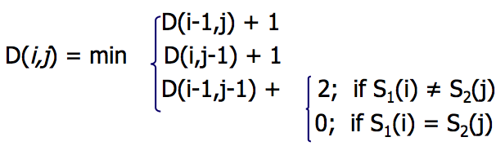
The Edit Distance Table
N | 9
O | 8
I | 7
T | 6
N | 5
E | 4
T | 3
N | 2
I | 1
# | 0 | 1 | 2 | 3 | 4 | 5 | 6 | 7 | 8 | 9
 | # | E | X | E | C | U | T | I | O | N

Slide 208
Edit Distance
N | 9
O | 8
I | 7
T | 6
N | 5
E | 4
T | 3
N | 2
I | 1
# | 0 | 1 | 2 | 3 | 4 | 5 | 6 | 7 | 8 | 9
 | # | E | X | E | C | U | T | I | O | N

Slide 209
The Edit Distance Table
N | 9 | 8 | 9 | 10 | 11 | 12 | 11 | 10 | 9 | 8
O | 8 | 7 | 8 | 9 | 10 | 11 | 10 | 9 | 8 | 9
I | 7 | 6 | 7 | 8 | 9 | 10 | 9 | 8 | 9 | 10
T | 6 | 5 | 6 | 7 | 8 | 9 | 8 | 9 | 10 | 11
N | 5 | 4 | 5 | 6 | 7 | 8 | 9 | 10 | 11 | 10
E | 4 | 3 | 4 | 5 | 6 | 7 | 8 | 9 | 10 | 9
T | 3 | 4 | 5 | 6 | 7 | 8 | 7 | 8 | 9 | 8
N | 2 | 3 | 4 | 5 | 6 | 7 | 8 | 7 | 8 | 7
I | 1 | 2 | 3 | 4 | 5 | 6 | 7 | 6 | 7 | 8
# | 0 | 1 | 2 | 3 | 4 | 5 | 6 | 7 | 8 | 9
 | # | E | X | E | C | U | T | I | O | N

Slide 210
Minimum Edit Distance
Computing Minimum Edit Distance

Slide 211
Minimum Edit Distance
Backtrace for Computing Alignments

Slide 212
Computing alignments
Edit distance isn’t sufficient
  We often need to align each character of the two strings to each other
We do this by keeping a “backtrace”
Every time we enter a cell, remember where we came from
When we reach the end,
  Trace back the path from the upper right corner to read off the alignment

Slide 213
Edit Distance
N | 9
O | 8
I | 7
T | 6
N | 5
E | 4
T | 3
N | 2
I | 1
# | 0 | 1 | 2 | 3 | 4 | 5 | 6 | 7 | 8 | 9
 | # | E | X | E | C | U | T | I | O | N

Slide 214
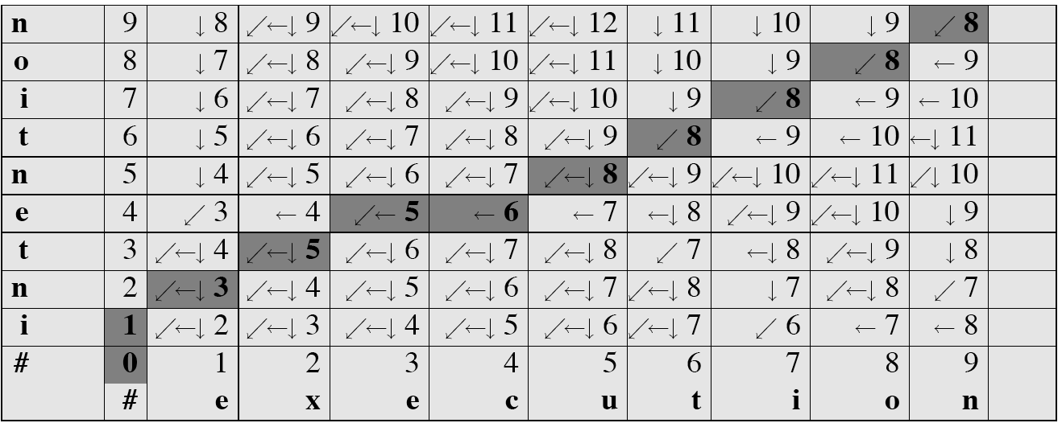
MinEdit with Backtrace

Slide 215
Adding Backtrace to Minimum Edit Distance
Base conditions: Termination:
  D(i,0) = i D(0,j) = j D(N,M) is distance
Recurrence Relation:
  For each i = 1…M
  For each j = 1…N
  D(i-1,j) + 1
  D(i,j)= min D(i,j-1) + 1
  D(i-1,j-1) + 2; if X(i) ≠ Y(j)
  0; if X(i) = Y(j)
  LEFT
  ptr(i,j)= DOWN
  DIAG
deletion
insertion
substitution
insertion
deletion
substitution

Slide 216
The Distance Matrix
Every non-decreasing path
from (0,0) to (M, N)
corresponds to
an alignment
of the two sequences
x₀ …………………… x_{N}
An optimal alignment is composed of optimal subalignments
y₀ ……………………………… y_{M}

Slide 217
Result of Backtrace
Two strings and their alignment:

Slide 218
Performance
Time:
  O(nm)
Space:
  O(nm)
Backtrace
  O(n+m)

Slide 219
Minimum Edit Distance
Backtrace for Computing Alignments

Slide 220
Minimum Edit Distance
Weighted Minimum Edit Distance

Slide 221
Weighted Edit Distance
Why would we add weights to the computation?
  Spell Correction: some letters are more likely to be mistyped than others
  Biology: certain kinds of deletions or insertions are more likely than others

Slide 222
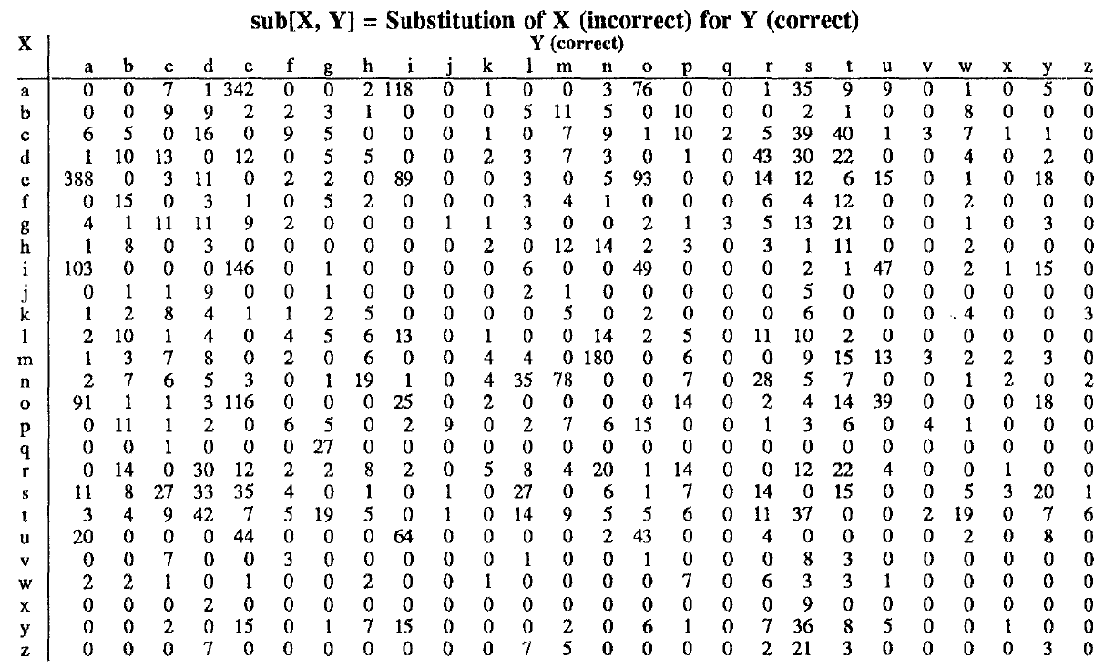
Confusion matrix for spelling errors

Slide 223
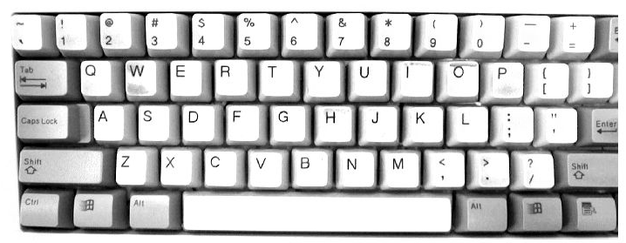

Slide 224
Weighted Min Edit Distance
Initialization:
  D(0,0) = 0
  D(i,0) = D(i-1,0) + del[x(i)]; 1 < i ≤ N
  D(0,j) = D(0,j-1) + ins[y(j)]; 1 < j ≤ M
Recurrence Relation:
  D(i-1,j) + del[x(i)]
  D(i,j)= min D(i,j-1) + ins[y(j)]
  D(i-1,j-1) + sub[x(i),y(j)]
Termination:
  D(N,M) is distance

Slide 225
Where did the name, dynamic programming, come from?
…The 1950s were not good years for mathematical research. [the] Secretary of Defense …had a pathological fear and hatred of the word, research…
I decided therefore to use the word, “programming”.
I wanted to get across the idea that this was dynamic, this was multistage… I thought, let’s … take a word that has an absolutely precise meaning, namely dynamic… it’s impossible to use the word, dynamic, in a pejorative sense. Try thinking of some combination that will possibly give it a pejorative meaning. It’s impossible.
Thus, I thought dynamic programming was a good name. It was something not even a Congressman could object to.”
Richard Bellman, “Eye of the Hurricane: an autobiography” 1984.

Slide 226
Minimum Edit Distance
Weighted Minimum Edit Distance

